Slide 1
MySQL Access Control System

Slide 2
Access Control
MySQL implements a sophisticated access control and privilege system that allows you to create comprehensive access rules for handling client operations and effectively preventing unauthorized clients from accessing the database system.
The MySQL access control has two stages when a client connects to the server:
Connection verification: a client, which connects to the MySQL database server, needs to have a valid username and password. In addition, the host from which the client connects has to match with the host in the MySQL grant table.
Request verification: once a connection is established successfully, for each statement issued by the client, MySQL checks whether the client has sufficient privileges to execute that particular statement. MySQL has the ability to check a privilege at the database, table, and field levels.

Slide 3
Creating Account and Granting Privileges
The following examples show how to use the mysql client program to set up new accounts. These examples assume that the MySQL root account has the CREATE USER privilege and all privileges that it grants to other accounts.
At the command line, connect to the server as the MySQL root user, supplying the appropriate password at the password prompt:
shell> mysql -u root -p
Enter password: (enter root password here)
After connecting to the server, you can add new accounts.

Slide 4
Account and privileges
CREATE USER 'finley'@'localhost'
IDENTIFIED BY 'password';
GRANT ALL
ON *.*
TO 'finley'@'localhost'
WITH GRANT OPTION;
CREATE USER 'finley'@'%.example.com'
IDENTIFIED BY 'password';
GRANT ALL
ON *.*
TO 'finley'@'%.example.com'
WITH GRANT OPTION;
CREATE USER 'admin'@'localhost'
IDENTIFIED BY 'password';
GRANT RELOAD,PROCESS
ON *.*
TO 'admin'@'localhost';
CREATE USER 'dummy'@'localhost';
The following example uses CREATE USER and GRANT statements to set up four accounts (where you see 'password', substitute an appropriate password)(Global level)
Notes:
Two accounts have a user name of finley. Both are superuser accounts with full global privileges to do anything.
The 'finley'@'localhost' account can be used only when connecting from the local host. The 'finley'@'%.example.com'account uses the '%' wildcard in the host part, so it can be used to connect from any host in the example.com domain.
The 'finley'@'localhost' account is necessary if there is an anonymous-user account for localhost. Without the'finley'@'localhost' account, that anonymous-user account takes precedence when finley connects from the local host and finley is treated as an anonymous user. The reason for this is that the anonymous-user account has a more specific Hostcolumn value than the 'finley'@'%' account and thus comes earlier in the user table sort order. (For information about usertable sorting, see Section 6.2.5, “Access Control, Stage 1: Connection Verification”.)
The 'admin'@'localhost' account can be used only by admin to connect from the local host. It is granted the global RELOAD andPROCESS administrative privileges. These privileges enable the admin user to execute the mysqladmin reload, mysqladmin refresh, and mysqladmin flush-xxx commands, as well as mysqladmin processlist . No privileges are granted for accessing any databases. You could add such privileges using GRANT statements.
The 'dummy'@'localhost' account has no password (which is insecure and not recommended). This account can be used only to connect from the local host. No privileges are granted. It is assumed that you will grant specific privileges to the account usingGRANT statements.

Slide 5
Lower level access
CREATE USER 'custom'@'localhost'
IDENTIFIED BY 'password';
GRANT ALL
ON bankaccount.*
TO 'custom'@'localhost';
CREATE USER 'custom'@'host47.example.com'
IDENTIFIED BY 'password';
GRANT SELECT,INSERT,UPDATE,DELETE,CREATE,DROP
ON expenses.*
TO 'custom'@'host47.example.com';
CREATE USER 'custom'@'%.example.com'
IDENTIFIED BY 'password';
GRANT SELECT,INSERT,UPDATE,DELETE,CREATE,DROP
ON customer.addresses
TO 'custom'@'%.example.com';
Previous example grants privileges at the global level.
The next example creates three accounts and grants them access at lower levels; that is, to specific databases or objects within databases. Each account has a user name of custom, but the host name parts differ:
Notes:
The three accounts can be used as follows:
The 'custom'@'localhost' account has all database-level privileges to access the bankaccount database. The account can be used to connect to the server only from the local host.
The 'custom'@'host47.example.com' account has specific database-level privileges to access the expenses database. The account can be used to connect to the server only from the host host47.example.com.
The 'custom'@'%.example.com' account has specific table-level privileges to access the addresses table in the customerdatabase, from any host in the example.com domain. The account can be used to connect to the server from all machines in the domain due to use of the % wildcard character in the host part of the account name.

Slide 6
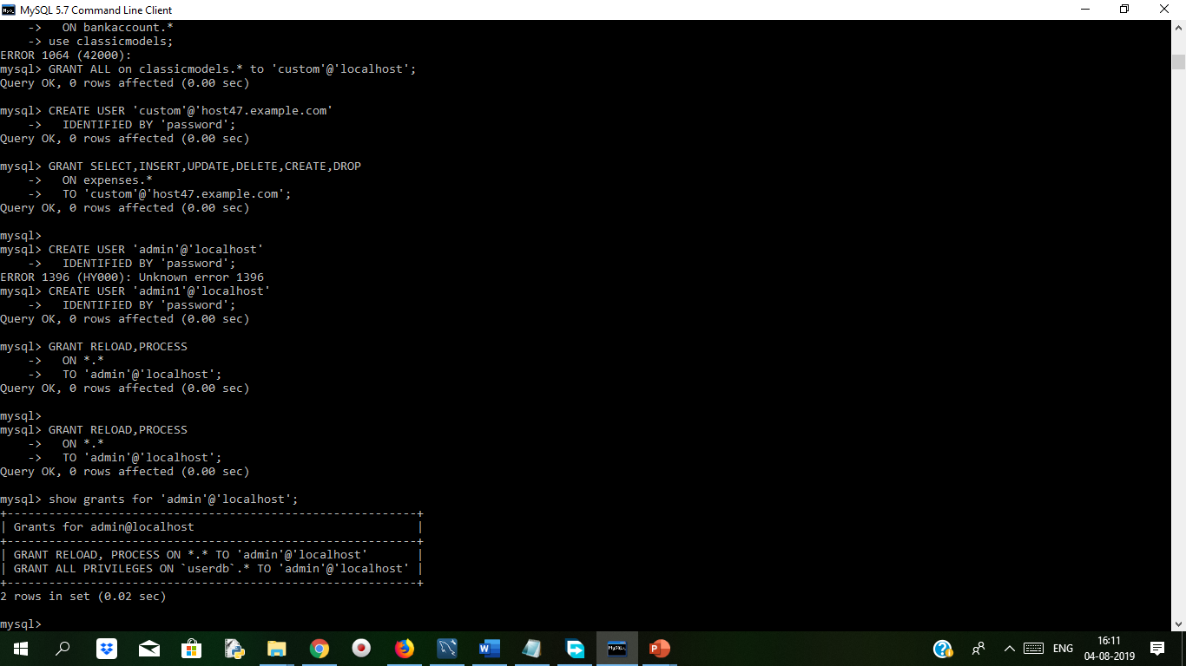
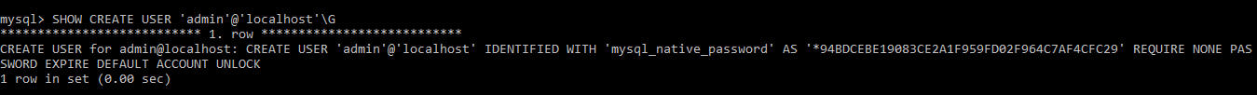
Checking Account Privileges and Properties
To see the privileges for an account, use SHOW GRANTS:
SHOW GRANTS FOR 'admin'@'localhost';
To see nonprivilege properties for an account, use SHOW CREATE USER:
SHOW CREATE USER 'admin'@'localhost’\G
We can see below result

Slide 7
Revoking Account Privileges
To revoke account privileges, use the REVOKE statement. Privileges can be revoked at different levels, just as they can be granted at different levels.
Revoke global privileges:
REVOKE ALL
ON *.*
FROM 'finley'@'%.example.com';
REVOKE RELOAD
ON *.*
FROM 'admin'@'localhost';
Revoke database-level privileges:
REVOKE CREATE,DROP
ON expenses.*
FROM 'custom'@'host47.example.com';
Revoke table-level privileges:
REVOKE INSERT,UPDATE,DELETE
ON customer.addresses
FROM 'custom'@'%.example.com';

Slide 8
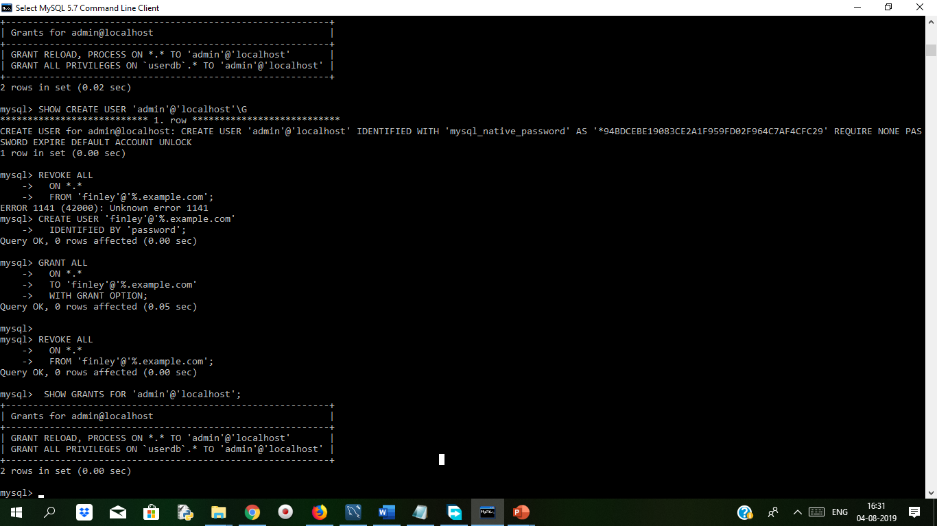
Check Revoke
To check the effect of privilege revocation, use SHOW GRANTS:
mysql> SHOW GRANTS FOR 'admin'@'localhost';

Slide 9
When the MySQL REVOKE command takes effect
The effect of MySQL REVOKE statement depends on the privilege level as follows:
The changes that are made to the global privileges only take effect when the client connects to the MySQL in the subsequent sessions. The changes are not applied to all currently connected users.
The changes of the database privileges are applied after the next USE statement.
The changes of table and column privilege are applied to all queries issued after the changes were made.

Slide 10
Dropping Accounts
To remove an account, use the DROP USER statement. For example, to drop some of the accounts created previously:
DROP USER 'finley'@'localhost';
DROP USER 'finley'@'%.example.com';
DROP USER 'admin'@'localhost';
DROP USER 'dummy'@'localhost';
Notes:
Ref:
https://dev.mysql.com/doc/refman/5.7/en/creating-accounts.html

